Slide 1
Overview of Alternative Project Delivery at CDOT

Slide 2
Project Delivery Methods
Design-Bid-Build
CM/GC
Design-Build
Construction Manager
Designer
Owner
Designer
Owner
Owner
Design-Build Team (Designer and Contractor)
Contractor

Slide 3
What type of projects does CDOT do?
We also do a small percentage of projects in the vertical world, and those are handled by our facilities management group.
These projects involve construction of our headquarters buildings, maintenance facilities, and lab and monitoring stations.
Most of our projects however are constructed in the XY plane. So we are “Horizontal” constructors.
Most of our projects are Heavy Highway Construction Projects.

Slide 4
What are some of the observed difference?
Level of involvement of the owner
State and Federal Requirements for
Project management
Procurement
Design and Construction
Financial and funding
Materials etc.
Third party negotiations- that can affect the critical path.
Rail roads
Ditch riders
Utility
Funding partners with unique and specific scope, and specifications.
Vertical projects typically (as I have observed):
Have a different type of owner
They are looking for a more turn key design-build or CMGC(CMAR) relationship.
One ROW Owner (more than likely the same as the project owner)
Utility negotiations are different the Owners risk.
Horizontal industry uses Vertical to see where the industry is headed.

Slide 5
How our management teams are organized
Requires a much more robust Owners Representation/Verification Team.
Design-Build
Executive Oversight Committee – to ensure real-time decision making.
Project management team- with representation on the design committees, and in the Field.
Performance Auditors- to hold the Design-Build Team accountable to the Technical Requirements.
Owner Verification- To validate the Contractors quality data for use in our “Acceptance Decision”

Slide 6
Administration of our CM/GC projects
Requires a much more robust Owners Representation/Verification Team.
Construction Manager/General Contractor
Owners Representation in design committees- instructed to provide guidance and leadership to the design, to ensure the efficiency of the scope.
Rely heavily on our Independent Cost Estimators to challenge our Contractors means and methods. Again, to encourage efficiency.
Double blind negotiation process.

Slide 7
Our change in approach to CM/GC
For CM/GC to be a good use of Taxpayer investment, the department must negotiate in good faith. Therefore…
The CM and the GC opportunity must be divorced
When we select a CM we are selecting them exclusively as a special consultant during the pre-construction phase.
We must always be willing to walk away from negotiation, and “Off-Ramp” the package for advertisement on the market.
We cannot at anytime infer or otherwise collude with our contractor to guarantee them any portion of the work.

Slide 8
When do we enter into a General Contract?
Only when we successfully negotiate a “Construction Agreed upon Price” will we execute a separate General Contract (GC) with our CM. (no amendments to the CM contract)
This includes procurement of long lead time items (LLTP’s)
Sequencing and Phasing of construction packages requires the packages to be severable and independent.
Minimize any owner sponsored change orders to add scope
Just negotiate a separate package.
No amendments to the package.

Slide 9
When do we enter into a General Contract? (continued)
Each package gets a separate GC with its own:
Clearance packages
Environmental, ROW, Railroad, and Utilities
Bid Schedule
Schedule
Drawdown
Now how do we decide which delivery method to use on a project…

Slide 10
How does CDOT decide which Method to use?
CDOT has developed a specific tool to document and assist project teams in selecting the right method for the right project.
Project Delivery Selection Matrix (PDSM)
https://www.codot.gov/business/alternativedelivery/pdsm

Slide 11
How does CDOT decide which Method to use?
Project Delivery Selection Matrix (PDSM)
Goals and Risk analysis tools that guides project teams through five primary discussions to determine Opportunities and Obstacles of each delivery method that may be leveraged to encourage the success of the specific project.
Requires a 4-8 hour workshop to complete the PDSM
The PDSM is not currently required for all projects

Slide 12
How does CDOT decide which Method to use?
The Primary Factors:
Project Complexity and Innovation
Project Delivery Schedule
Project Cost Considerations
Level of Design
Risk Assessment
The Secondary Factors:
Staff Availability and Experience (Agency)
Level of Oversight and Control
Competition and Contractor Experience

Slide 13
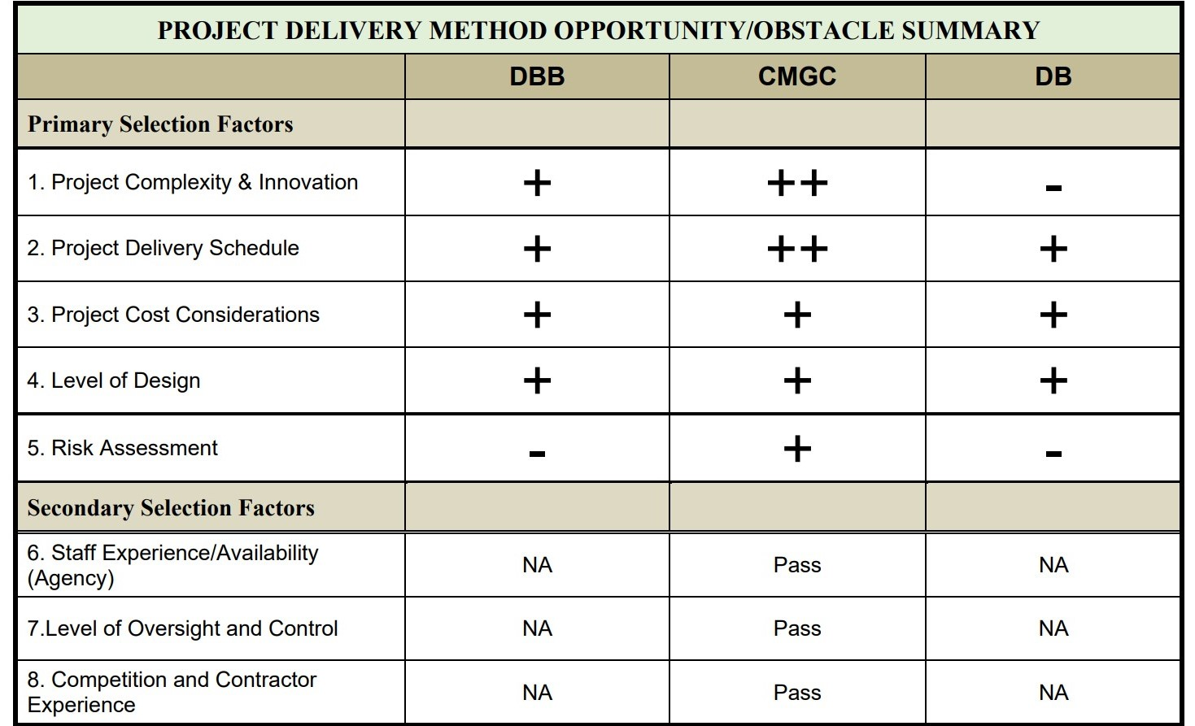
How does CDOT decide which Method to use?
Example PDSM Summary Matrix

Slide 14
Project Delivery Methods
Design-Bid-Build
CM/GC
Design-Build
Construction Manager
Designer
Owner
Designer
Owner
Owner
Design-Build Team (Designer and Contractor)
Contractor

Slide 15
Are there Other Alternative Delivery Methods?
Spectrum of Project Delivery at CDOT
Design Bid Build
Project Specific Pre-Qualifications
DBB-Best Value
CM/GC
Progressive Design Build
Design-Build
Indefinite Delivery Indefinite Quantity (ID/IQ)
Project Stardust
Integrated Contractor

Slide 16
For further discussion and assistance contact
Matthew D. Pacheco, P.E.
Alternative Delivery Program Manager
VM: 303-512-5455
matthew.pacheco@state.co.us
Casey Valentinelli, P.E.
Alternative Delivery Program
VM: 970-385-3636
casey.valentinelli@state.co.us

